Slide 1
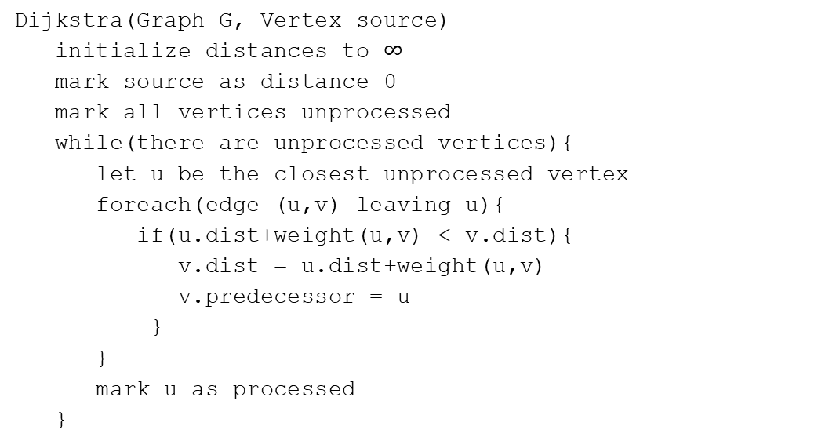
Dijkstra’s Algorithm
Vertex | Distance | Predecessor | Processed
s
w
x
u
v
t
Dijkstra(Graph G, Vertex source)
initialize distances to $∞$
mark source as distance 0
mark all vertices unprocessed
while(there are unprocessed vertices){
let u be the closest unprocessed vertex
foreach(edge (u,v) leaving u){
if(u.dist+weight(u,v) < v.dist){
v.dist = u.dist+weight(u,v)
v.predecessor = u
}
}
mark u as processed
}
1
1
w
x
1
s
u
v
t
20
1
1

Slide 2
Dijkstra’s Algorithm
Vertex | Distance | Predecessor | Processed
s | 0 | -- | Yes
w | 1 | s | Yes
x | 2 | w | Yes
u | 20 3 | s x | Yes
v | 4 | u | Yes
t | 5 | v | Yes
Dijkstra(Graph G, Vertex source)
initialize distances to $∞$
mark source as distance 0
mark all vertices unprocessed
while(there are unprocessed vertices){
let u be the closest unprocessed vertex
foreach(edge (u,v) leaving u){
if(u.dist+weight(u,v) < v.dist){
v.dist = u.dist+weight(u,v)
v.predecessor = u
}
}
mark u as processed
}
1
1
w
x
1
s
u
v
t
20
1
1

Slide 3
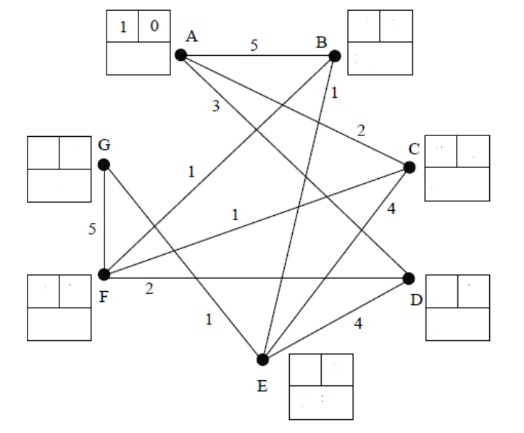
Dijkstra’s Algorithm
An algorithm for finding the shortest path between two vertices in a graph

Slide 4
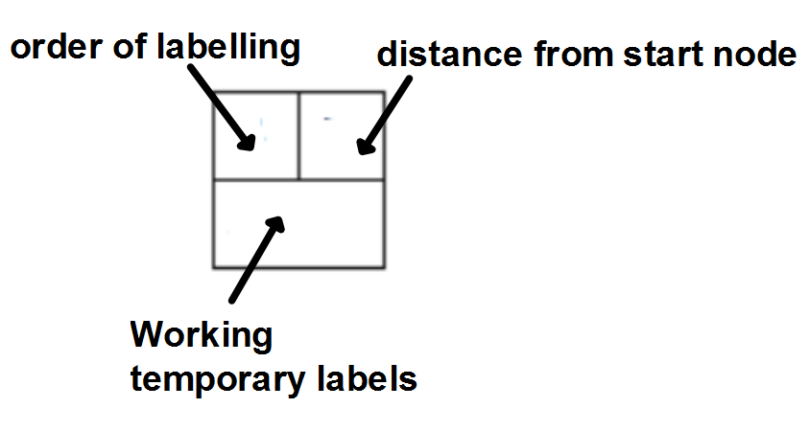

Slide 5
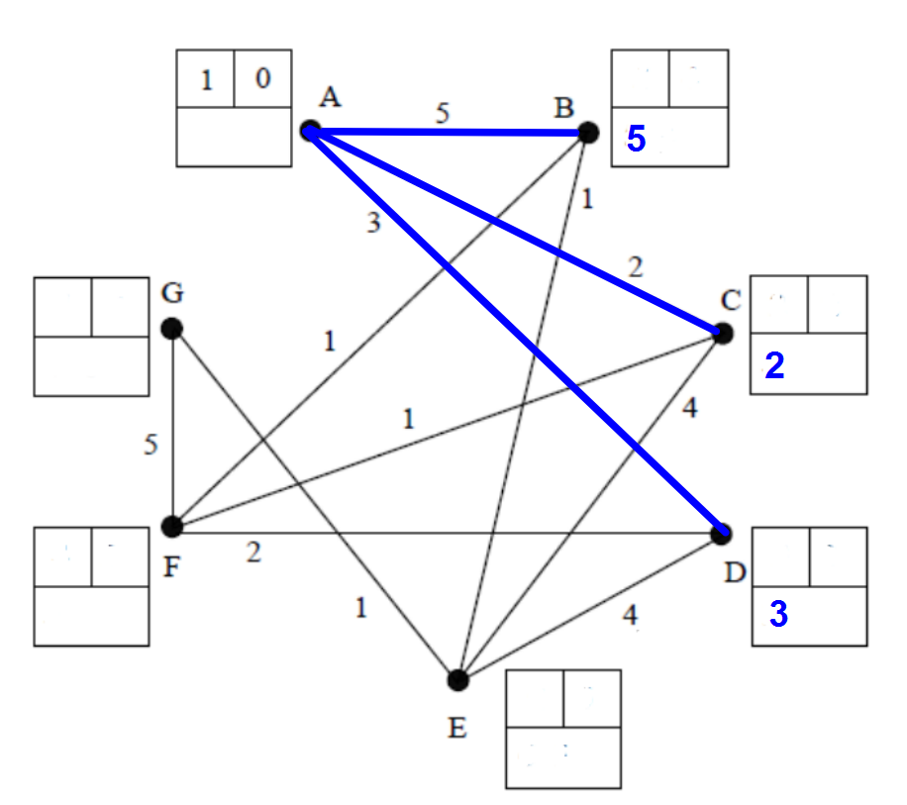
Start vertex order label 1
distance label 0
temporary labels
given to B, C, D

Slide 6
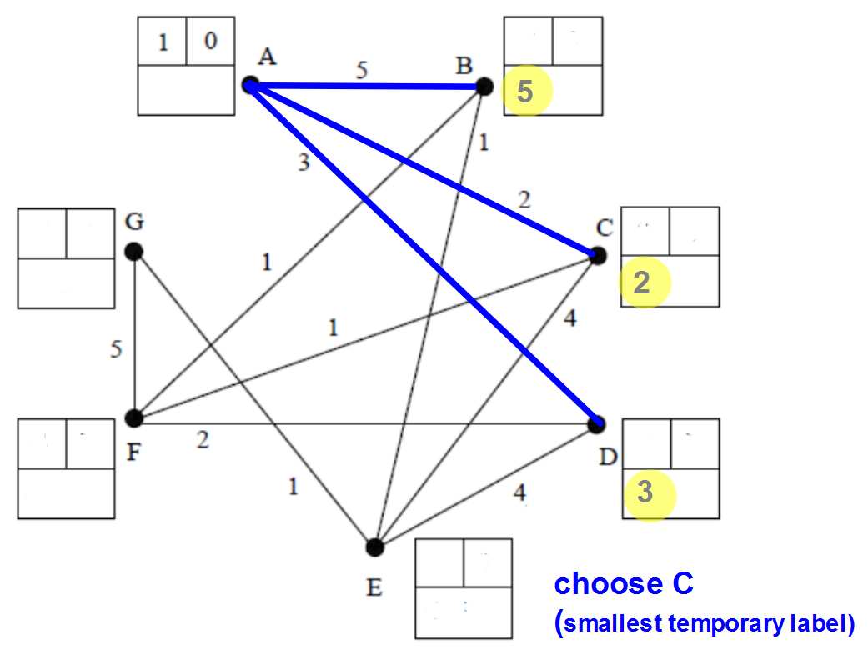

Slide 7
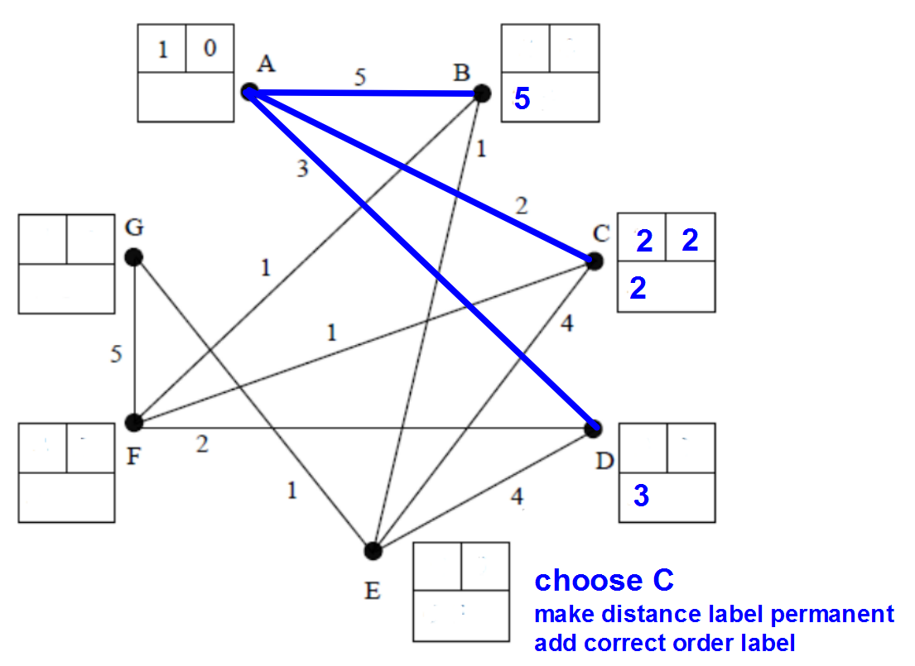

Slide 8
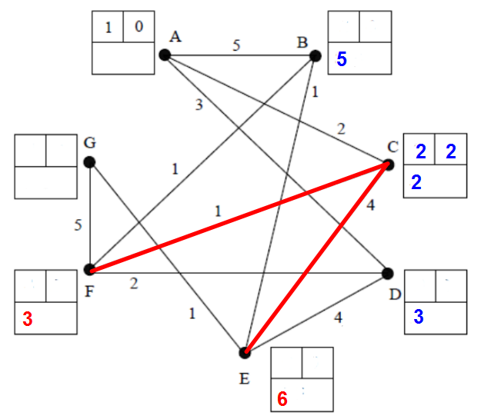

Slide 9
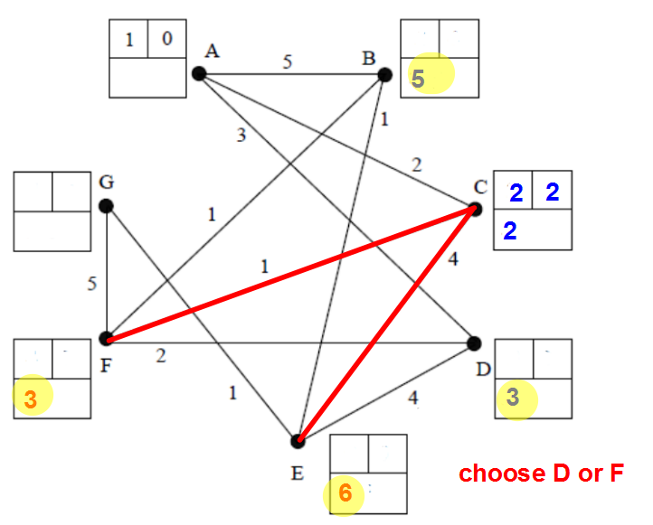

Slide 10
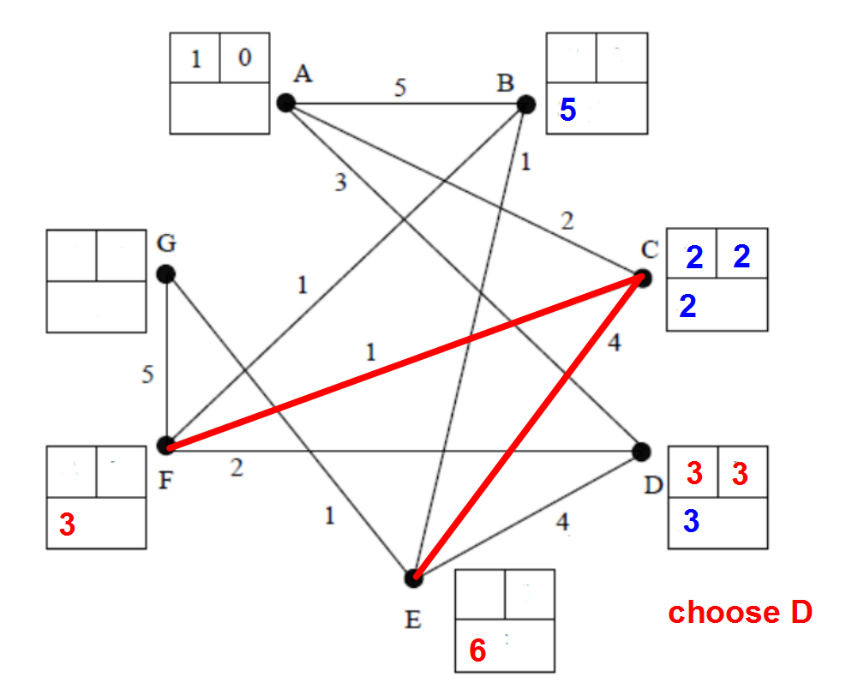

Slide 11
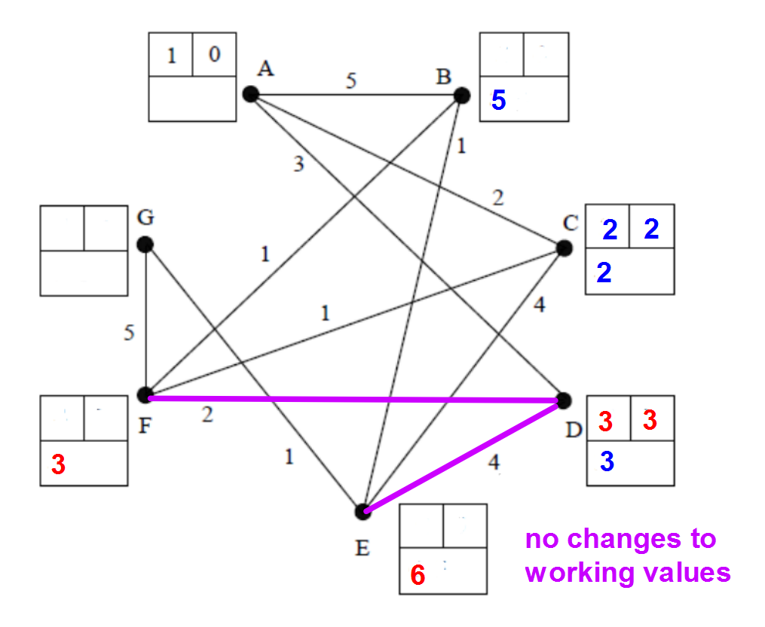

Slide 12
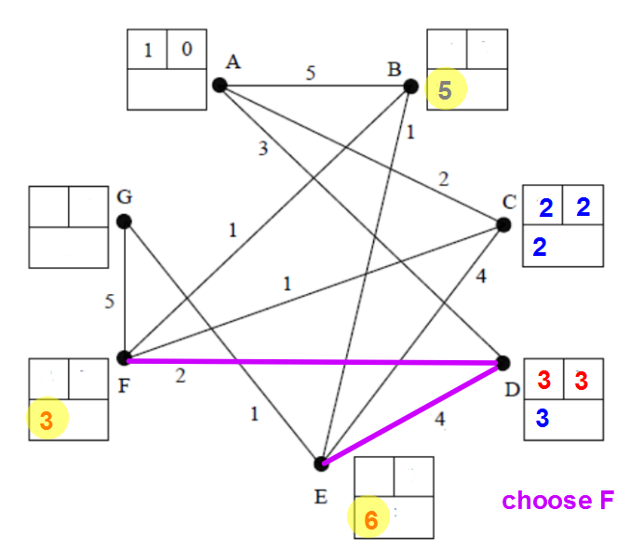

Slide 13
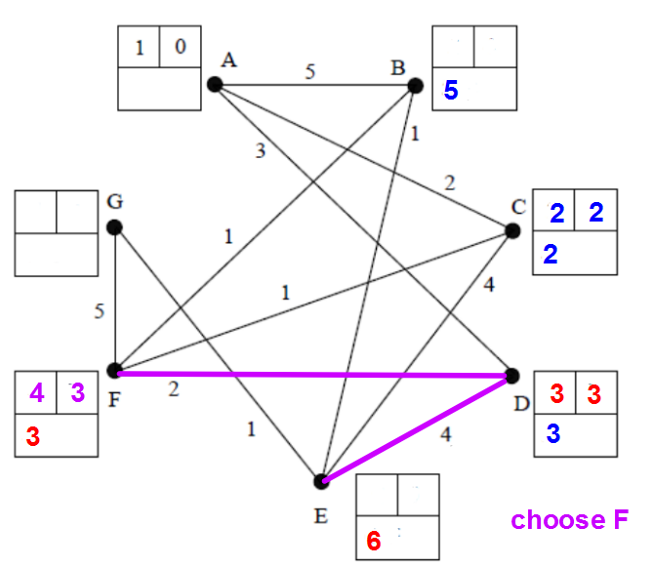

Slide 14
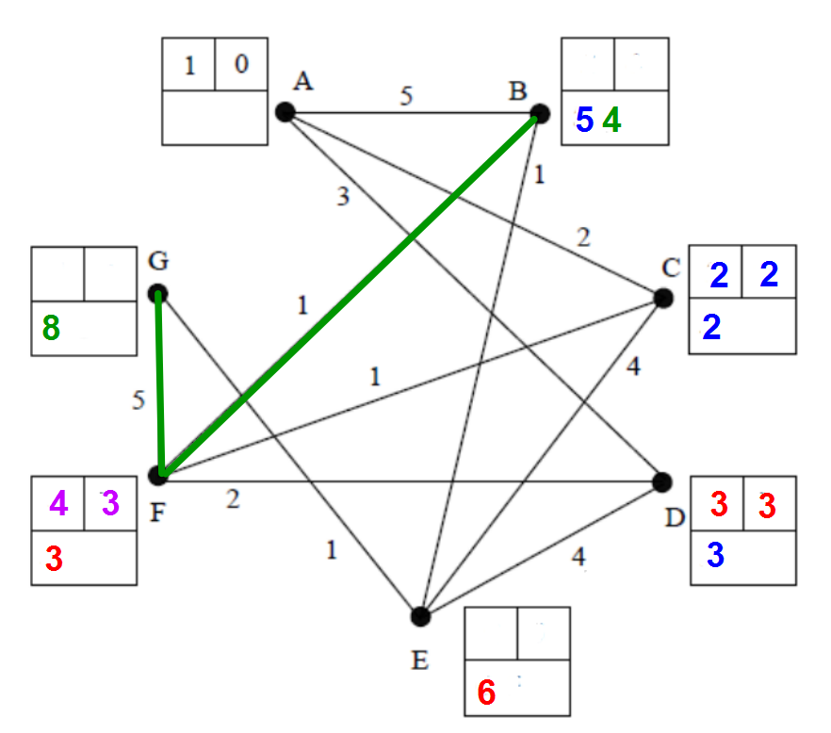

Slide 15
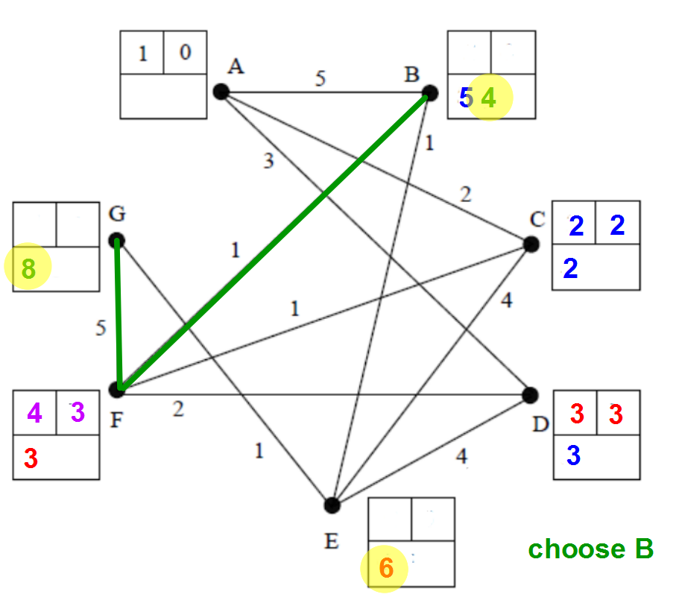

Slide 16
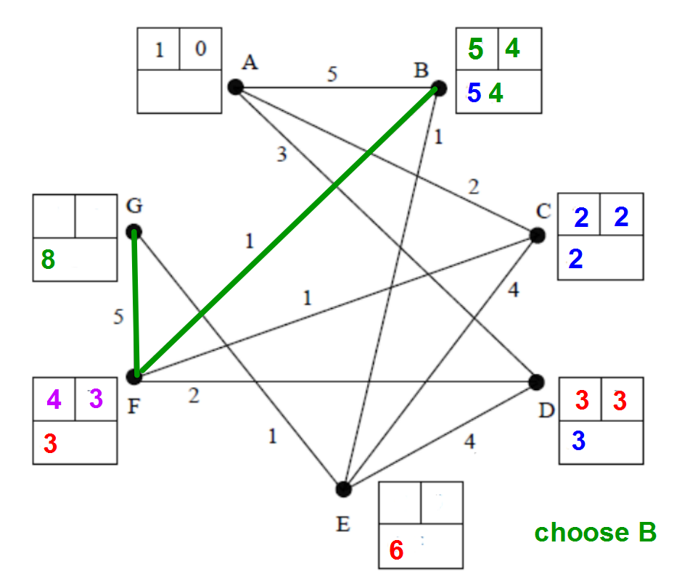

Slide 17
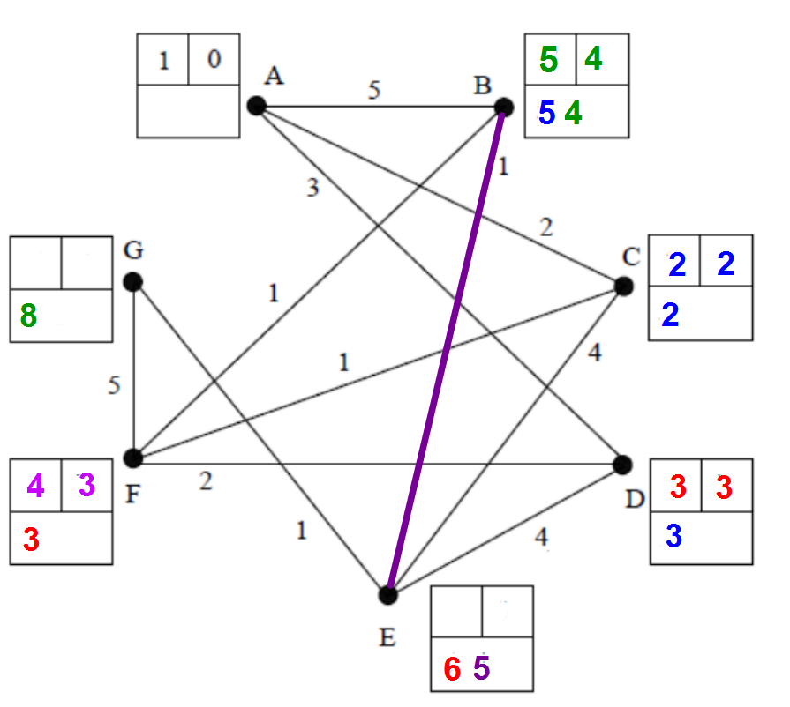

Slide 18
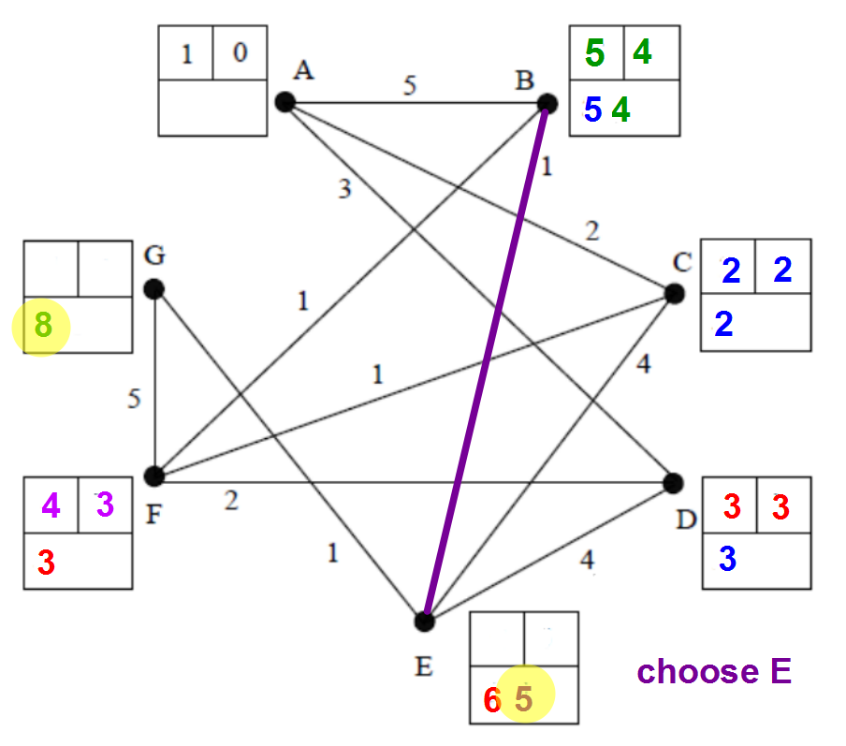

Slide 19
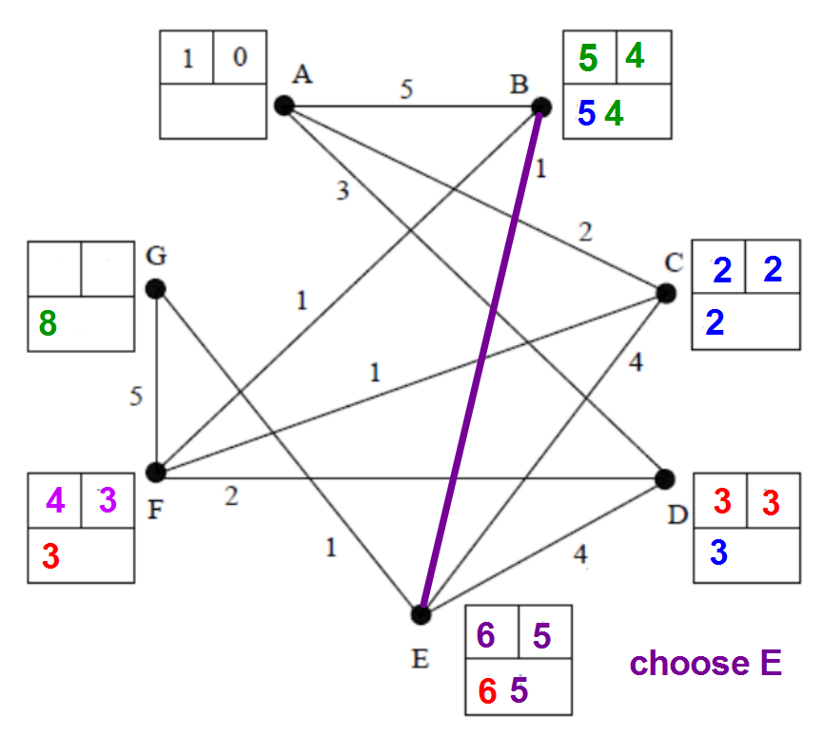

Slide 20
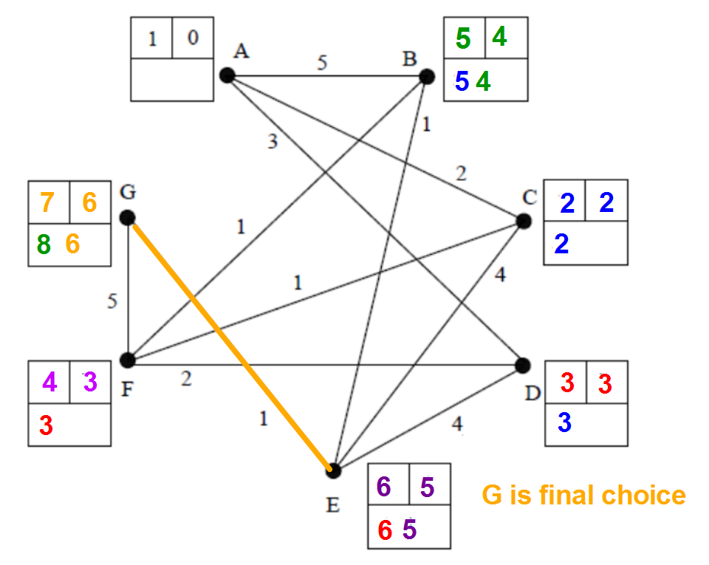

Slide 21
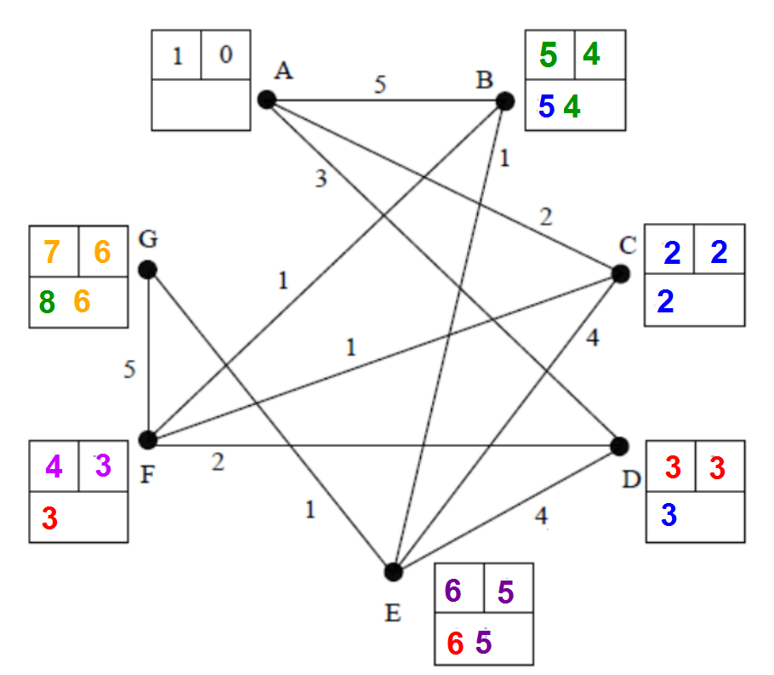
Shortest distances
AB 4 ACFB
AC 2 AC
AD 3 AD
AE 5 ACFBE
AF 3 ACF
AG 6 ACFBFG

